Slide 1
System Programming: Introduction

Slide 2
System Programming
Unit 1: Introduction to System Programming
Introduction, Assemblers , Macro Processors, RISC machines,
Unit 2: Macro Processor and Assembler
Unit 3: Compilers, Loaders and Linkers
Unit 4: Essential concepts of Systems programming for Linux as Open Source OS.
Unit 5: Encoding, Decoding and Device drivers
Unit 6: TSR Programming
7/29/15
1
Notes:
1

Slide 3
Hardware vs. Software
Hardware
All physical contents of computer are hardware. This form is given to all electrical and mechanical devices attached to the computer for the purpose of input, process, and storage and output operations
Software
Software is a general term used for computer Programs. A computer program is a planned, step by step set of instructions that directs the computer what to do and how to do.
7/29/15
1
Notes:
1

Slide 4
Introduction to System Programming
Software
Software is the name given to the computer programs that instruct the hardware how to work.
Software are the instructions in the form of programs which control the operation of a computer, together with the associated documentation.
Without software, the computer would do absolutely nothing
More precisely, a software means a collection of programs whose objective is to enhance the capabilities of the hardware.
Notes:
Software refers to the set of computer programs, procedures and associated documents(flowcharts) which describe the program and how they are to be used.
More precisely, a software means a collection of programs whose objective is to enhance the capabilities of the hardware.
A software package is a group of programs which solve a specific problem or perform a specific type of job.
E.g.: A word processing package may contain programs for text- editing, text formatting, spell checking etc.
Hence, a multipurpose computer system has several software packages, one each for every type of job it can perform.
Software includes things such as websites, programs or video games, that are coded by programming languages like C or C++.
"Software" is sometimes used in a broader context to mean anything which is not hardware but which is used with hardware, such as film, tapes and records.
1

Slide 5
Types Of Software
System Software
The programs directly related to the computer hardware and perform tasks associated with controlling and utilizing computer hardware
Application Software
An application is a job or task a user wants to accomplish through a computer.
Application software are programs that help a user perform a specific job.
Notes:
1

Slide 6
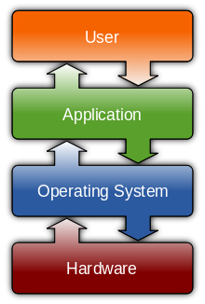
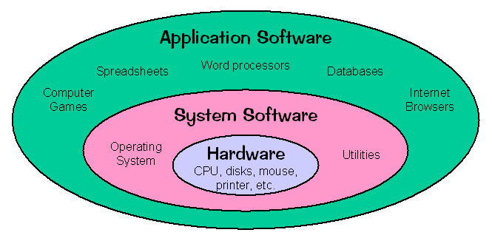
How it is?
Notes:
System Software consists of a variety of programs that support the operation of a computer.
• The software makes it possible for the users to focus on an application or other problem to be solved, without needing to know the details of how the machine works internally.
1

Slide 7
System Software
System software is computer software designed to operate the computer hardware, to provide basic functionality, and to provide a platform for running application software.
System software includes device drivers, operating systems, servers, utilities, and window systems.
System software is responsible for managing a variety of independent hardware components, so that they can work together harmoniously.
System programs manages internal operation of Computer also manages peripherals like storage Devices, Monitor, Printer.
1
Notes:
1
A systems programmer installs, customizes and maintains the operating system
To do this they need knowledge of
Hardware
Storage
Processor
Software
System libraries and data sets
Current customization

Slide 8
System Software
Machine dependency of system software
–System programs are intended to support the operation and use of the computer.
–Machine architecture differs in:
•Machine code
•Instruction formats
•Addressing mode
•Registers
Machine independency of system software
–General design and logic is basically the same:
•Code optimization
•Subprogram linking
1
Notes:
1

Slide 9
System Software
System software helps run the computer hardware and computer system. It includes combination of the following:
Device drivers
Operating systems
Servers
Utilities
Compiler
Assembler
Notes:
1

Slide 10
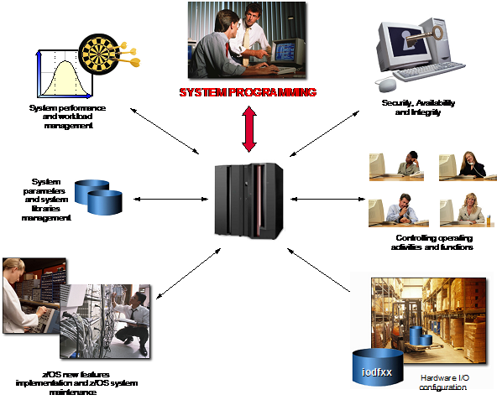
Notes:
Security & Integrity:
Protection of data against unsauthorized disclosure, transfer, modification or destruction
Systems programmer installs and maintains the security system
Unauthorized software must not be able to access authorized states
Workload Manager
Workload manager (WLM) is an address space which manages the tasks running on the system
Uses an installation-defined policy to determine relative priority of competing workloads
WLM can also be used to manage hardware resources
1

Slide 11
Need Of System Software
System control programs
controls the execution of programs, manage the storage & processing resources of the computer & perform other management & monitoring function.
The most important of these programs is the operating system.
System support programs
provide routine service functions to the other computer programs & computer users: E.g. Utilities, libraries,
Ex:Text editors, language translators such as BASIC interpreter
System Development Programs
They assists in the creation of computer programs. Examples of system development are –
Language translations.

Slide 12
Application software
Application software are the software that are designed to satisfy a particular need of a particular environment.
Guides the computer to carry out instructions provided by the user.
Application Software can’t work without System Software.
Examples of application software are-student record software, railway reservation software, income tax software, word processors etc.
Notes:
1
Application software are the software that are designed to satisfy a particular need of a particular environment.
All software prepared by us in the computer lab.
Examples of application software are-student record software, railway reservation software, income tax software, word processors etc.
Examples include enterprise software, accounting software, office suites, graphics software and media players.

Slide 13
Application software
1) Opera (Web Browser) 2) Microsoft Word (Word Processing) 3) Microsoft Excel (Spreadsheet software) 5) MySQL (Database Software) 6) Microsoft Powerpoint (Presentation Software) 7) iTunes (Music / Sound Software) 8) VLC Media Player (Audio / Video Software) 9) World of Warcraft (Game Software) 10) Adobe Photoshop (Graphics Software)
Notes:
People use productivity software to become more effective and efficient while performing daily activities. Word processing software allows users to create and manipulate documents that contain text and graphics. With word processing software, you can insert clip art into a document; change margins; find and replace text; use a spelling checker to check spelling; place a header and footer at the top and the bottom of a page; and vary font (character design), font size (character scale), and font style (character appearance).
With spreadsheet software, data is organized in rows and columns, which collectively are called a worksheet. The intersection of a row and column, called a cell, can contain a label (text), a value(number), or a formula or function that performs calculations on the data and displays the result.
Database software allows you to create and manage a database. A database is a collection of data organized to allow access, retrieval, and use of that data. A query is used to retrieve data according to specified criteria, which are restrictions the data must meet.
Presentation graphics software is used to create presentations that communicate ideas, messages, and other information to a group through a slide show. You can use a clip gallery to enhance your presentation with clip art images, pictures, video clips, and audio clips.
A personal information manager (PIM) is software that includes an appointment calendar to schedule activities, an address book to maintain names and addresses, and a notepad to record ideas, reminders, and important information. A software suite is a collection of individual applications sold as a single package.
Project management software allows you to plan, schedule, track, and analyze the progress of a project. Accounting software helps companies record and report their financial transactions.
Power users often use software that allows them to work with graphics and multimedia. Computer-aided design (CAD) software assists in creating engineering, architectural, and scientific designs. Desktop publishing (DTP) software is used to design and produce sophisticated documents. DTP is developed specifically to support page layout, which is the process of arranging text and graphics in a document. Paint software is used to draw graphical images with various on-screen tools. Image editing software provides the capability to modify existing images. Video editing software and audio editing software can be used to modify video and audio segments.
Multimedia authoring software is used to create electronic interactive presentations that can include text, images, video, audio, and animation. Web page authoring software is designed to create Web pages and to organize, manage, and maintain Web sites.
Many software applications are designed specifically for use at home or for personal or educational use. Integrated software combines several productivity software applications that share a similar interface and common features into a single package. Personal finance software is an accounting program that helps pay bills, balance a checkbook, track income and expenses, follow investments, and evaluate financial plans. Legal software assists in the creation of legal documents and provides legal advice. Tax preparation software guides users through the process of filing federal taxes. Personal DTP software helps develop conventional documents by asking questions, presenting predefined layouts, and supplying standard text.
Photo-editing software is used to edit digital photographs. A clip art/image gallery is a collection of clip art and photographs that can be used in all types of documents. Home design/landscaping software assists with planning or remodeling. Educational software teaches a particular skill and exists for about any subject. Reference software provides valuable and thorough information for all individuals. Entertainment software includes interactive games, videos, and other programs designed to support a hobby or provide amusement.
One of the main reasons people use computers is to communicate and share information. E-mail software is used to create, send, receive, forward, store, print, and delete e-mail (electronic mail). A Web browser is a software application used to access and view Web pages. A chat client is software that allows you to connect to a chat room, which permits users to chat via the computer. A newsreader is a software program used to participate in a newsgroup, which is an online area on the Web where users conduct written discussion about a particular subject. An instant messenger is a software program installed to use instant messaging (IM), a real-time communications service that notifies you when one or more people are online and then allows you to exchange messages or files. Groupware is a software application that helps groups of people on a network work together and share information. A videoconference is a meeting
1

Slide 14
System Software vs. Application Software
System Software | Application Software
Provides an platform for an user to interact with hardware of computer | Runs on System software for serving specific purpose.
Run in background and act as platform | Run in foreground & interact with user
e.g Language Processor, Operating System, Disk Driver | e.g. Video games, Text Editor & Browser
Is often done in low level language & C where programs have to manage memory themselves. | Is ofetn done in languages Java C#, Pearl, Python, Ruby, Javascript that feature automatic garbage collection & free the programmer from low level worries.

Slide 15
Evolution of Programming
Machine Language
Binary format
11100101100111110001000000010000
11100101100111110000000000001000
11100000100000010101000000000000
11100101100011110101000000001000
Hexadecimal format
E59F1010
E59F0008
E0815000
E58F5008

Slide 16
Evolution of Programming
Assembly Language
Mnemonic codes
E59F1010 LDR R1, num1
E59F0008 LDR R0, num2
E0815000 ADD R5, R1, R0
E58F5008 STR R5, sum
High-Level Language
C language
sum = num1 + num2;

Slide 17
Components of System Software:
The system software includes
– Assembler
– Linker
– Loader
– Macro processor
– Text editor
– Compiler
– Operating system
– Debugging system
Notes:
– Source Code Control System
– (optional) Database Management System
1

Slide 18
From Source to Executable
Source Code
Object Code
Preprocessor
Linker
Libraries
Preprocessed Code
Executable Code
Compiler
Loader
Assembly Code
Debugger
Assembler

Slide 19
Components of System Software:
Text editor (hello.c)
– To create and modify the program
– Editors rarely have the advanced formatting and other features of a regular word processor, but sometimes include special tools and features that are useful for programming.
Notes:
1

Slide 20
Components of System Software:
Pre-processor (hello.c -> hello.i)
–Includes the Headers
–Expand the macros
–Augmentation
#define identifier replacement
e.g. #define TABLE_SIZE 100
int table1[TABLE_SIZE];
int table2[TABLE_SIZE];
Conditional inclusions (#ifdef, #ifndef, #if, #endif, #else and #elif)
Notes:
Inclusion
▪ Copies the full content of a included file into the current file at the point at which the directive occurs
Eg.) #include “…” directive in ‘C’
❒ Macros
▪ Replace each macro call, in-line, with the corresponding macro definition
▪ E.g.) #define … … directive in ‘C’
❒ Conditional compilation (include or macro guard)
▪ In combination with macros, remove code fragments that need not be compiled
▪ E.g) #ifdef, #ifndef, #endif directives in ‘C’
Preprocessor directives
Preprocessor directives are lines included in the code of programs preceded by a hash sign (#). These lines are not program statements but directives for the preprocessor. The preprocessor examines the code before actual compilation of code begins and resolves all these directives before any code is actually generated by regular statements. These preprocessor directives extend only across a single line of code. As soon as a newline character is found, the preprocessor directive is ends. No semicolon (;) is expected at the end of a preprocessor directive. The only way a preprocessor directive can extend through more than one line is by preceding the newline character at the end of the line by a backslash (\). macro definitions (#define, #undef)
To define preprocessor macros we can use #define. Its syntax is: #define identifier replacement When the preprocessor encounters this directive, it replaces any occurrence of identifier in the rest of the code by replacement. This replacement can be an expression, a statement, a block or simply anything. The preprocessor does not understand C++ proper, it simply replaces any occurrence of identifier by replacement. 1 2 3 #define TABLE_SIZE 100 int table1[TABLE_SIZE]; int table2[TABLE_SIZE];
After the preprocessor has replaced TABLE_SIZE, the code becomes equivalent to: 1 2 int table1[100]; int table2[100];
#define can work also with parameters to define function macros: #define getmax(a,b) a>b?a:b
This would replace any occurrence of getmax followed by two arguments by the replacement expression, but also replacing each argument by its identifier, exactly as you would expect if it was a function: // function macro #include <iostream> using namespace std; #define getmax(a,b) ((a)>(b)?(a):(b)) int main() { int x=5, y; y= getmax(x,2); cout << y << endl; cout << getmax(7,x) << endl; return 0; }5 7Edit & Run
Defined macros are not affected by block structure. A macro lasts until it is undefined with the #undef preprocessor directive: #define TABLE_SIZE 100
int table1[TABLE_SIZE];
#undef TABLE_SIZE
#define TABLE_SIZE 200
int table2[TABLE_SIZE];
This would generate the same code as: int table1[100]; int table2[200];
Function macro definitions accept two special operators (# and ##) in the replacement sequence: The operator #, followed by a parameter name, is replaced by a string literal that contains the argument passed (as if enclosed between double quotes): #define str(x)
#x cout << str(test);
This would be translated into: cout << "test";
The operator ## concatenates two arguments leaving no blank spaces between them: 1 2 #define glue(a,b) a ## b glue(c,out) << "test";
This would also be translated into: cout << "test";
Because preprocessor replacements happen before any C++ syntax check, macro definitions can be a tricky feature. But, be careful: code that relies heavily on complicated macros become less readable, since the syntax expected is on many occasions different from the normal expressions programmers expect in C++. Conditional inclusions (#ifdef, #ifndef, #if, #endif, #else and #elif)
These directives allow to include or discard part of the code of a program if a certain condition is met. #ifdef allows a section of a program to be compiled only if the macro that is specified as the parameter has been defined, no matter which its value is. For example: 1 2 3 #ifdef TABLE_SIZE int table[TABLE_SIZE]; #endif
In this case, the line of code int table[TABLE_SIZE]; is only compiled if TABLE_SIZE was previously defined with #define, independently of its value. If it was not defined, that line will not be included in the program compilation. #ifndef serves for the exact opposite: the code between #ifndef and #endif directives is only compiled if the specified identifier has not been previously defined. For example: 1 2 3 4 #ifndef TABLE_SIZE #define TABLE_SIZE 100 #endif int table[TABLE_SIZE];
In this case, if when arriving at this piece of code, the TABLE_SIZE macro has not been defined yet, it would be defined to a value of 100. If it already existed it would keep its previous value since the #define directive would not be executed. The #if, #else and #elif (i.e., "else if") directives serve to specify some condition to be met in order for the portion of code they surround to be compiled. The condition that follows #if or #elif can only evaluate constant expressions, including macro expressions. For example: 1 2 3 4 5 6 7 8 9 10 11 12 13 14 #if TABLE_SIZE>200 #undef TABLE_SIZE #define TABLE_SIZE 200 #elif TABLE_SIZE<50 #undef TABLE_SIZE #define TABLE_SIZE 50 #else #undef TABLE_SIZE #define TABLE_SIZE 100 #endif int table[TABLE_SIZE];
Notice how the entire structure of #if, #elif and #else chained directives ends with #endif. The behavior of #ifdef and #ifndef can also be achieved by using the special operators defined and !definedrespectively in any #if or #elif directive: 1 2 3 4 5 6 7 #if defined ARRAY_SIZE #define TABLE_SIZE ARRAY_SIZE #elif !defined BUFFER_SIZE #define TABLE_SIZE 128 #else #define TABLE_SIZE BUFFER_SIZE #endif
Preprocessor directives
Preprocessor directives are lines included in the code of programs preceded by a hash sign (#). These lines are not program statements but directives for the preprocessor. The preprocessor examines the code before actual compilation of code begins and resolves all these directives before any code is actually generated by regular statements. These preprocessor directives extend only across a single line of code. As soon as a newline character is found, the preprocessor directive is ends. No semicolon (;) is expected at the end of a preprocessor directive. The only way a preprocessor directive can extend through more than one line is by preceding the newline character at the end of the line by a backslash (\). macro definitions (#define, #undef)
To define preprocessor macros we can use #define. Its syntax is: #define identifier replacement When the preprocessor encounters this directive, it replaces any occurrence of identifier in the rest of the code by replacement. This replacement can be an expression, a statement, a block or simply anything. The preprocessor does not understand C++ proper, it simply replaces any occurrence of identifier by replacement. 1 2 3 #define TABLE_SIZE 100 int table1[TABLE_SIZE]; int table2[TABLE_SIZE];
After the preprocessor has replaced TABLE_SIZE, the code becomes equivalent to: 1 2 int table1[100]; int table2[100];
#define can work also with parameters to define function macros: #define getmax(a,b) a>b?a:b
This would replace any occurrence of getmax followed by two arguments by the replacement expression, but also replacing each argument by its identifier, exactly as you would expect if it was a function: 1 2 3 4 5 6 7 8 9 10 11 12 13 14 // function macro #include <iostream> using namespace std; #define getmax(a,b) ((a)>(b)?(a):(b)) int main() { int x=5, y; y= getmax(x,2); cout << y << endl; cout << getmax(7,x) << endl; return 0; }5 7Edit & Run
Defined macros are not affected by block structure. A macro lasts until it is undefined with the #undef preprocessor directive: 1 2 3 4 5 #define TABLE_SIZE 100 int table1[TABLE_SIZE]; #undef TABLE_SIZE #define TABLE_SIZE 200 int table2[TABLE_SIZE];
This would generate the same code as: 1 2 int table1[100]; int table2[200];
Function macro definitions accept two special operators (# and ##) in the replacement sequence: The operator #, followed by a parameter name, is replaced by a string literal that contains the argument passed (as if enclosed between double quotes): 1 2 #define str(x) #x cout << str(test);
This would be translated into: cout << "test";
The operator ## concatenates two arguments leaving no blank spaces between them: 1 2 #define glue(a,b) a ## b glue(c,out) << "test";
This would also be translated into: cout << "test";
Because preprocessor replacements happen before any C++ syntax check, macro definitions can be a tricky feature. But, be careful: code that relies heavily on complicated macros become less readable, since the syntax expected is on many occasions different from the normal expressions programmers expect in C++. Conditional inclusions (#ifdef, #ifndef, #if, #endif, #else and #elif)
These directives allow to include or discard part of the code of a program if a certain condition is met. #ifdef allows a section of a program to be compiled only if the macro that is specified as the parameter has been defined, no matter which its value is. For example: 1 2 3 #ifdef TABLE_SIZE int table[TABLE_SIZE]; #endif
In this case, the line of code int table[TABLE_SIZE]; is only compiled if TABLE_SIZE was previously defined with #define, independently of its value. If it was not defined, that line will not be included in the program compilation. #ifndef serves for the exact opposite: the code between #ifndef and #endif directives is only compiled if the specified identifier has not been previously defined. For example: 1 2 3 4 #ifndef TABLE_SIZE #define TABLE_SIZE 100 #endif int table[TABLE_SIZE];
In this case, if when arriving at this piece of code, the TABLE_SIZE macro has not been defined yet, it would be defined to a value of 100. If it already existed it would keep its previous value since the #define directive would not be executed. The #if, #else and #elif (i.e., "else if") directives serve to specify some condition to be met in order for the portion of code they surround to be compiled. The condition that follows #if or #elif can only evaluate constant expressions, including macro expressions. For example: 1 2 3 4 5 6 7 8 9 10 11 12 13 14 #if TABLE_SIZE>200 #undef TABLE_SIZE #define TABLE_SIZE 200 #elif TABLE_SIZE<50 #undef TABLE_SIZE #define TABLE_SIZE 50 #else #undef TABLE_SIZE #define TABLE_SIZE 100 #endif int table[TABLE_SIZE];
Notice how the entire structure of #if, #elif and #else chained directives ends with #endif. The behavior of #ifdef and #ifndef can also be achieved by using the special operators defined and !definedrespectively in any #if or #elif directive: 1 2 3 4 5 6 7 #if defined ARRAY_SIZE #define TABLE_SIZE ARRAY_SIZE #elif !defined BUFFER_SIZE #define TABLE_SIZE 128 #else #define TABLE_SIZE BUFFER_SIZE #endif
1

Slide 21
Compiler
Compilation(hello.i -> hello.s)
It is a program which translates a high level language program into a machine language program (optionally with relocation)
A software program that converts source code that written in high level programming language into low level language.
A Native-compiler runs on a computer platform and produces code for that same computer platform.
A Cross-compiler runs on one computer platform and produces code for another computer platform.
Notes:
Compiler: It is a program which translates a high level language program into a machine language program. A compiler is more intelligent than an assembler. It checks all kinds of limits, ranges, errors etc. But its program run time is more and occupies a larger part of the memory. It has slow speed. Because a compiler goes through the entire program and then translates the entire program into machine codes. If a compiler runs on a computer and produces the machine codes for the same computer then it is known as a self compiler or resident compiler. On the other hand, if a compiler runs on a computer and produces the machine codes for other computer then it is known as a cross compiler.
A cross compiler is a compiler capable of creating executable code for a platform other than the one on which the compiler is running.
For example, a compiler that runs on a Windows 7 PC but generates code that runs on Android smartphone is a cross compiler.
1

Slide 22
Assembler
Converts mnemonic codes into object file. (hello.s -> hello.o )
Assemblers are further divided into two types: One Pass Assembler and Two Pass Assembler.
Converts symbolic (e.g., jump labels, variable names)
operands to their machine addresses
Uses proper addressing modes and formats to build efficient machine instructions
Outputs the object program and provide other information (e.g., for linker and loader)
Notes:
A program which translates an assembly language program into a machine language program is called an assembler. If an assembler which runs on a computer and produces the machine codes for the same computer then it is called self assembler or resident assembler. If an assembler that runs on a computer and produces the machine codes for other computer then it is called Cross Assembler.
Assemblers are further divided into two types: One Pass Assembler and Two Pass Assembler. One pass assembler is the assembler which assigns the memory addresses to the variables and translates the source code into machine code in the first pass simultaneously. A Two Pass Assembler is the assembler which reads the source code twice. In the first pass, it reads all the variables and assigns them memory addresses. In the second pass, it reads the source code and translates the code into object code.
1

Slide 23
Linker
A linker or link editor is a program that takes one or more objects generated by compilers and assembles them into a single executable program or a library .(concatenation, hello.o -> hello.exe)
Link the object files and libraries to form an executable
Notes:
As programs grow in size, requiring teams of programmers, there is a need to break them up into separate files so that different team members can work on their individual assignments without interfering with the work of others. Each file is compiled separately and then combined later.
Linkers are programs that combine the various parts of a large program into a single object program. Linkers also bring in support routines from libraries. These libraries contain utility and other support code that is reused over and over for lots of different programs.
Historically, linkers also served additional purposes that are no longer necessary, such as resolving relocatable code on early hardware (so that more than one program could run at the same time).
In high level languages, some built in header files or libraries are stored. These libraries are predefined and these contain basic functions which are essential for executing the program. These functions are linked to the libraries by a program called Linker. If linker does not find a library of a function then it informs to compiler and then compiler generates an error. The compiler automatically invokes the linker as the last step in compiling a program.
Not built in libraries, it also links the user defined functions to the user defined libraries. Usually a longer program is divided into smaller subprograms called modules. And these modules must be combined to execute the program. The process of combining the modules is done by the linker.
1

Slide 24
LOADER
Loader is a program that loads machine codes of a program into the system memory.
it places programs into memory and prepares them for execution.
Loading a program involves reading the contents of executable file into memory.
Notes:
A loader is a program that loads programs into main memory so that they can be run. In the past, a loader would have to be explicitely run as part of a job. In modern times the loader is hidden away in the operating system and called automatically when needed.
<number>

Slide 25
Debugger
A debugger or debugging tool is a computer program that is used to test and debug other programs.
The code to be examined might alternatively be running on an instruction set simulator .
When the program crashes, the debugger shows the actual position(Segment) in the original code if it is a source-level debugger.
If it is a low-level debugger or a machine-language debugger it shows that line in the program.

Slide 26
Emulator
An emulator is a piece of Hardware/Software that enables one computer system to run programs that are written for another computer system.
For example emulator 8086, 8086 microprocessor programs.
An emulator is used on the target processor (the processor for which the program is being written).

Slide 27
Interpreters
convert each high level instruction into a series of machine instructions and then immediately run (or execute) those instructions.
Allow a computer to interpret or understand, what the software program tells the computer to do, what task to perform.
Notes:
Interpreters convert each high level instruction into a series of machine instructions and then immediately run (or execute) those instructions. In some cases, the interpreter has a library of routines and looks up the correct routine from the library to handle each high level instruction.
Interpreters inherently run more slowly than the same software compiled. In the early days of computing this was a serious problem. Since the mid-1980s, computers have become fast enough that interpreters run fine for most purposes.
Most of the scripting languages common on the web and servers are intereted languages. This includes JavaScript, Perl, PHP, Python, Ruby.
Note that some modern programming languages (including Java and Python) translate the raw text into an intermediate numeric code (usually a byte code) for a virtual machine. This method is generally faster than older traditional methods of interpreting scripts and has the advantage of providing a pkatform-independent stored code.
<number>

Slide 28
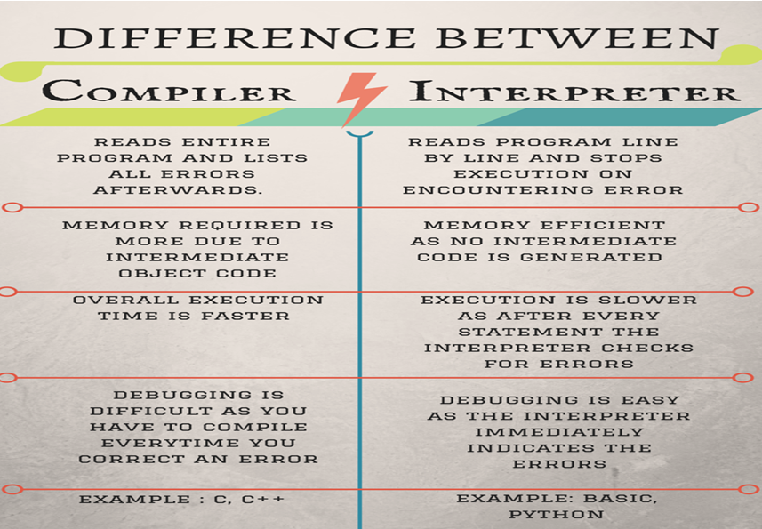

Slide 29
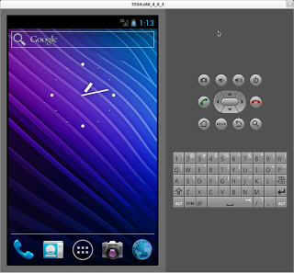
Emulator Example
Android Virtual Machine(AVM)

Slide 30
Thank you!!! Any Question..??

Slide 31
Notes:
Preprocessor
Expansion of Header files
Substitute macros and inline functions
Compiler
Generates assembly language
Verification of functions usage using prototypes
Header files: Prototypes declaration
Assembler
Generates re-locatable object file (contains m/c instructions)
nm app.o 0000000000000000 T main U puts
Nm or objDump tool used to view object files
Linker
Generates executable file (nm tool used to view exe file (Hello))
Binds appropriate libraries
Static Linking
Dynamic Linking (default) Timing of linking: At Load time or At Run time
Loader
Evaluate size of code and data segment
Allocates address space in the user mode and transfers them into memory
Load dependent libraries needed by program and links them
Invokes Process Manager à Program registration
<number>

Slide 32
Language Processor
• language processor, a program that processes programs written in a programming language (source language)
• language processor is a language translator, which translates the program from the source language into machine code, assembly language, or some other language.
• The machine code can be for an actual computer or for a virtual (hypothetical) computer.
• If it is for a virtual computer, then a simulator for the virtual computer is needed in order to execute the translated program.

Slide 33
Language processor
1. Analysis Phase
2. Synthesis Phase

